Slide 1
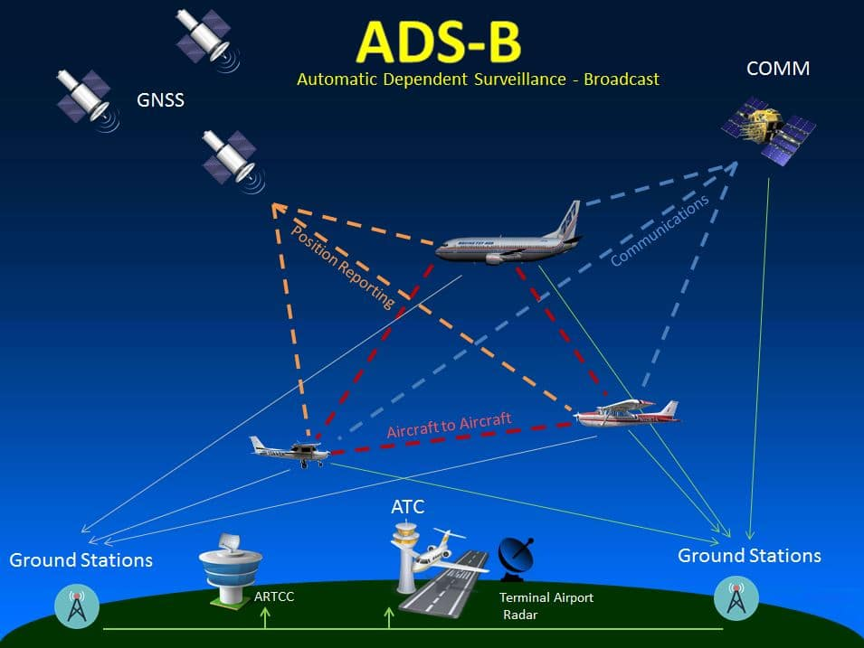

Jim Price

Slide 2
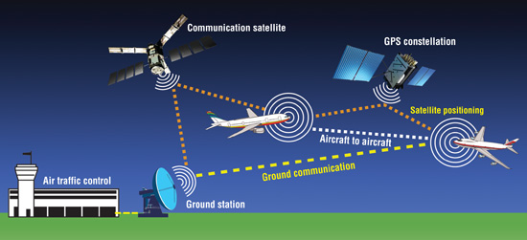



ADS-B

Slide 3



ADS-B
Notes:
ATC in the 30s

Slide 4
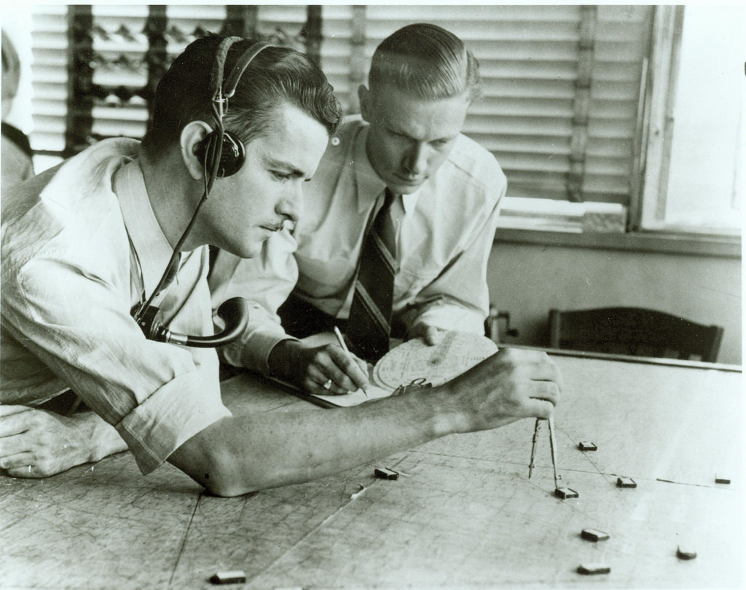

Slide 5



June 30, 1956 Grand Canyon – Changes Everything

Slide 6

1958 Radars Installed Controllers Hired

Slide 7
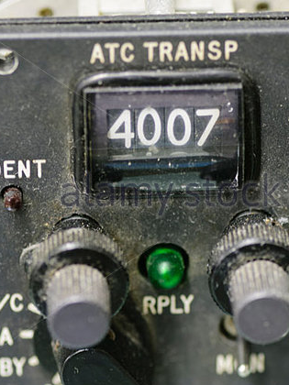
1960 Transponder Mandate

Slide 8
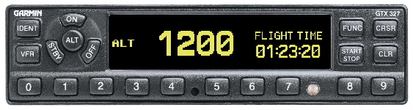
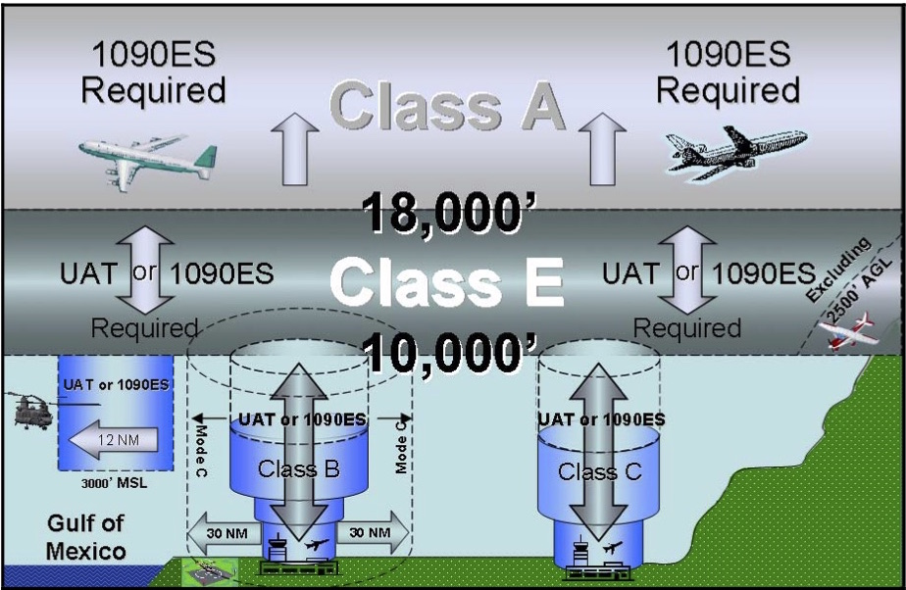
1988 Mode C Mandate

Slide 9



May 1988
Notes:
In 1988, we have what Richard Collins called “Mode C Madness”

Slide 10


Anti Mode C Mandate Points
It’s going to strike the deathblow against general aviation because of the high equipage costs.
Mode C transponders are too pricey.
They provide no benefit to pilots.
Too many airplanes needed to be equipped in too short a time.
1X

Slide 11
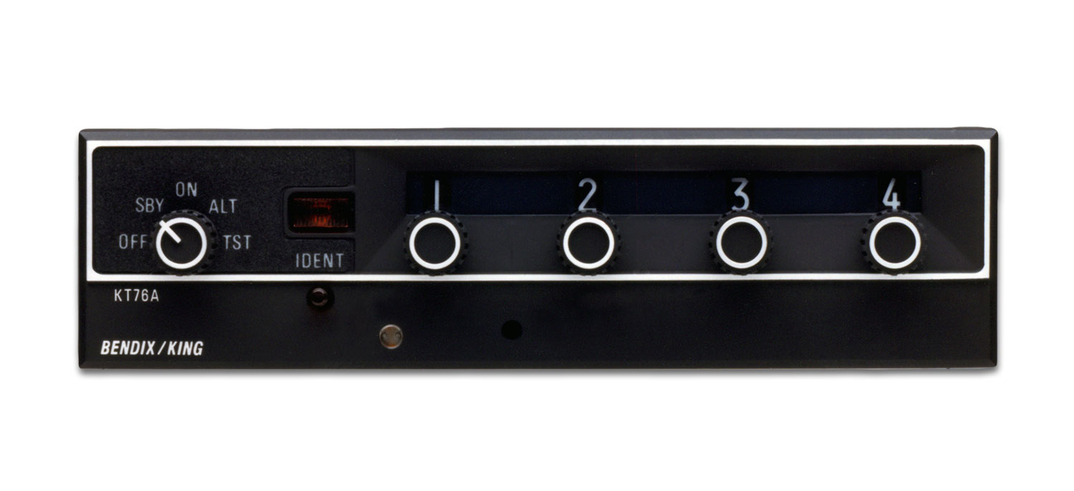
And yet . . .

Slide 12
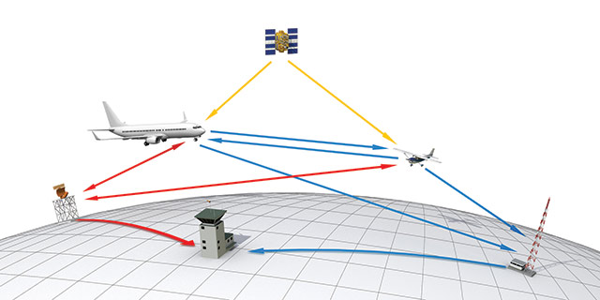
2008 – NextGen / ADS-B
Final Rule: May 2010

Slide 13
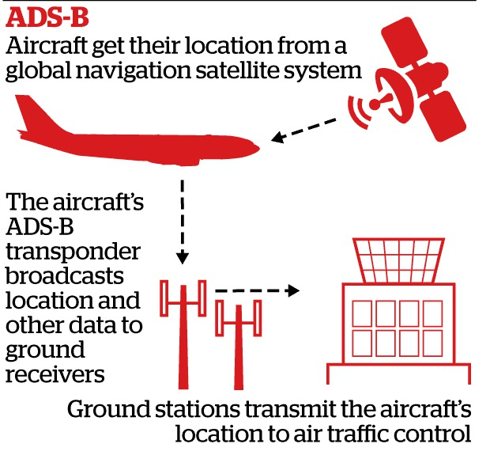

ADS-B
Every
Second

Slide 14
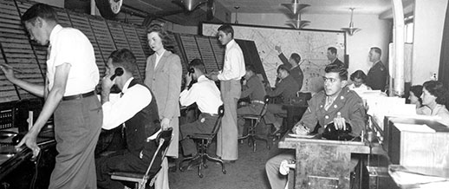

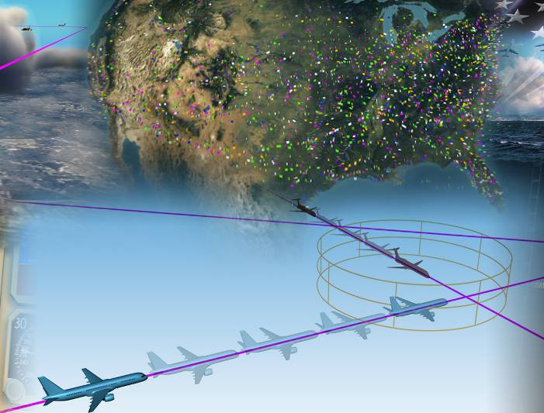


Slide 15
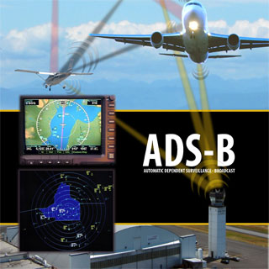

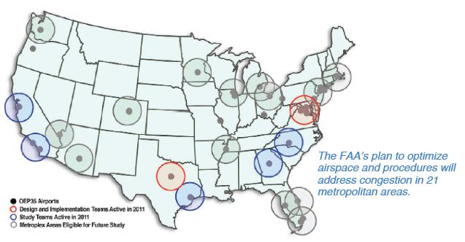
Vi
ADS-B
Notes:
NextGen programs are expected to improve how traffic flies into, through, and out of 13 areas called metroplexes by the FAA. These are areas with several airports and high amounts of traffic.

Slide 16


ADS-B
Notes:
Questions

Slide 17

ADS-B
ADS-B
Data
Comm
Decision
Support
Systems
(DSS)
NAS
Voice
System
(NVS)
System Wide
Information
Management
(SWIM)
Notes:
Questions

Slide 18
Vi
ADS-B
Notes:
. . . but the star of the show is ADS-B

Slide 19

ADS-B
A
utomatic
broadcasting your position every second
Notes:
Automatic - Always ON and requires no identing or interrogation

Slide 20
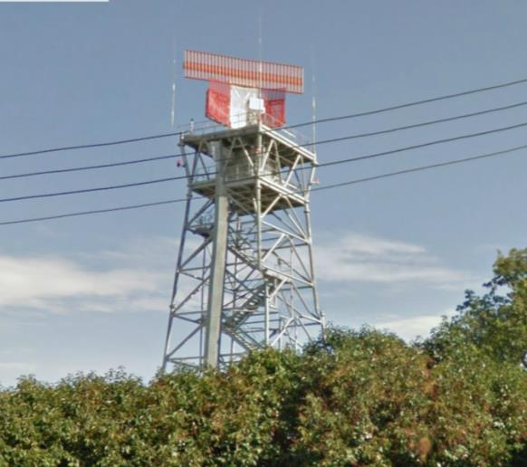

RADAR RPM: 5 – 12.5
12 Sec
4.8 sec

Slide 21

Is that aircraft there?
. . . or is it where it was
12 seconds ago?

Slide 22
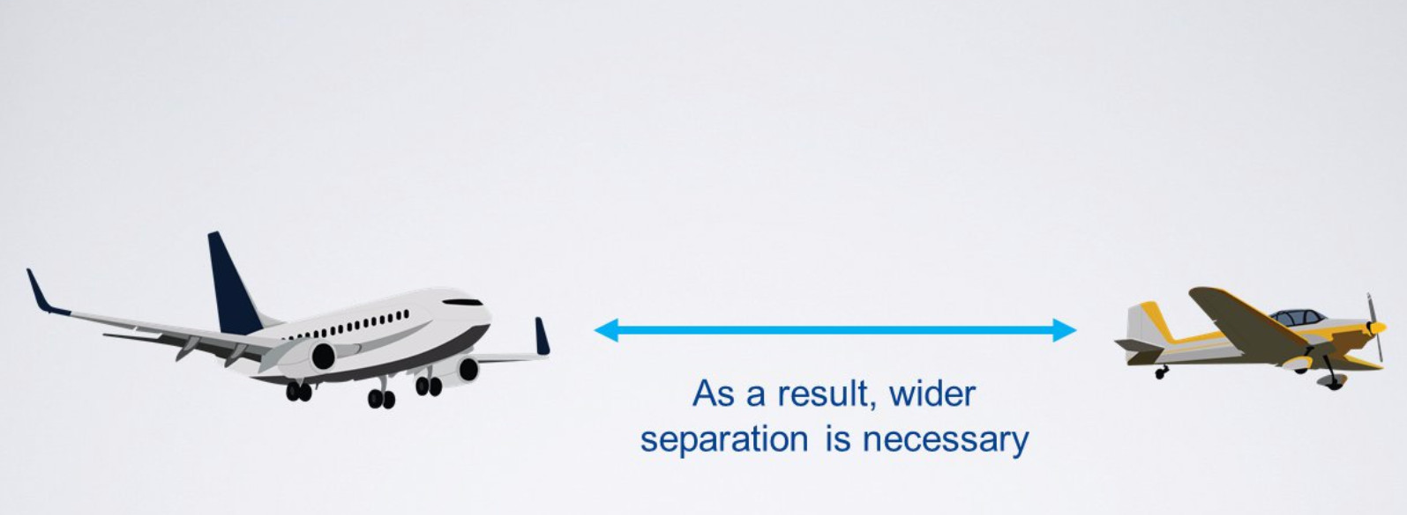

Slide 23
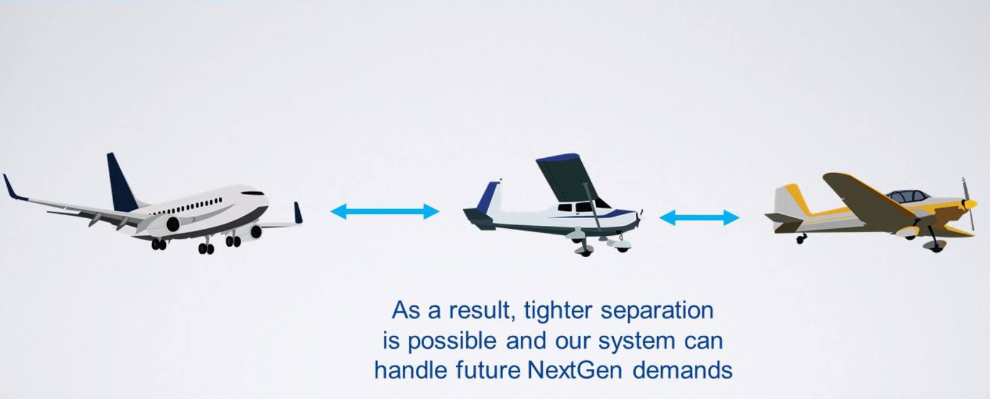
ADS-B : Reports position every second

Slide 24
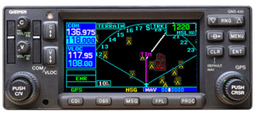
ADS-B
D
ependent
Depends on WAAS GPS
for Position Reports
Notes:
Dependent - It depends on an accurate GPS signal for position data.

Slide 25

ADS-B
S
urveillance
Notes:
Surveillance - It provides surveillance services, but in a more timely manner than today’s RADAR

Slide 26
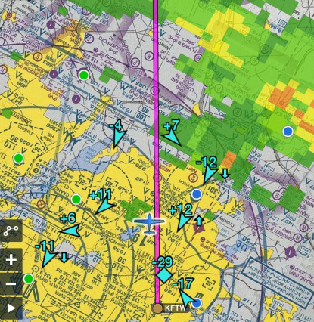
ADS-B
B
roadcast
Notes:
Broadcast –It continuously broadcasts aircraft position and other data to an ADS-B ground station, and aircraft that are equipped to receive ADS-B, giving you weather on your iPad or panel mounted GPS.

Slide 27

ADS-B is now operational at all airports, Terminal Radar Approach Control Facilities, which handle busy airspace around airports, and en route facilities, which handle high altitude traffic
Oct 8, 2019

Slide 28
ADS-B is the preferred source of surveillance

Slide 29

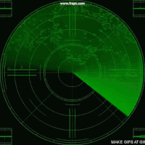
RADAR’s Future after 2020

Slide 30
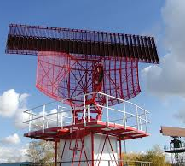
Most Terminal RADARs will be gone

Slide 31
Keep all Class B Terminal RADARs + 9 more

Slide 32

Keep all Long-Range RADARs

Slide 33

GPS Failures

Slide 34


Slide 35
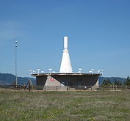
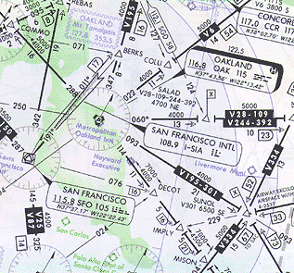
VOR Approaches & Airways

Slide 36
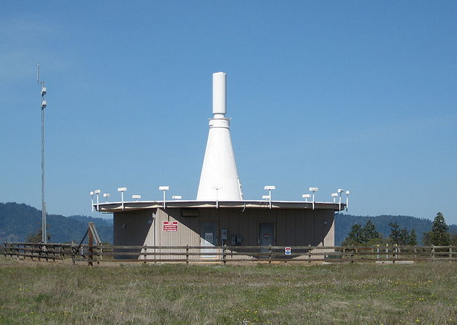
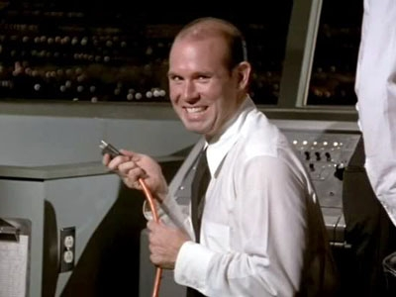
ADS-B/NextGen
Pulling the Plug on 308 Federal VORs

Slide 37
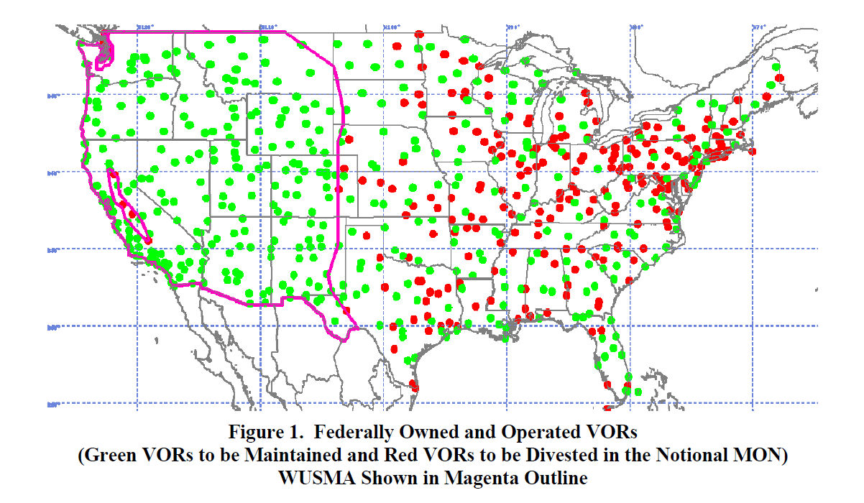

Slide 38
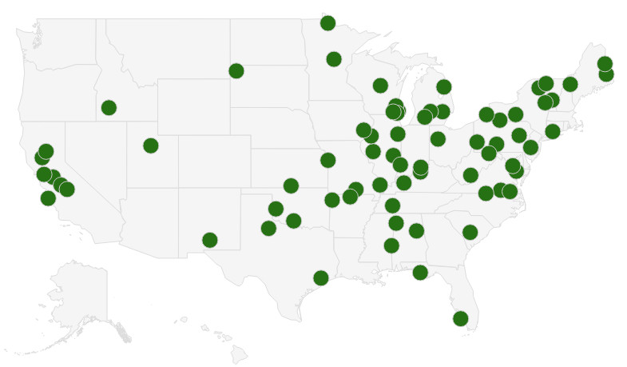
Phase 1: 2016 - 2020
Eliminate 74 VORs

Slide 39
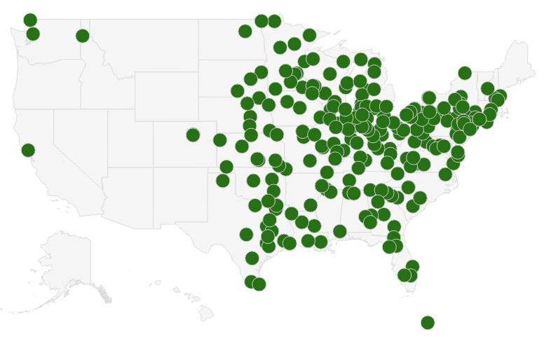
Phase 2: 2020 - 2025
Eliminate 234 VORs

Slide 40

Retain VORs for coverage at 5,000' AGL and above across the entire CONUS
Fail

Slide 41
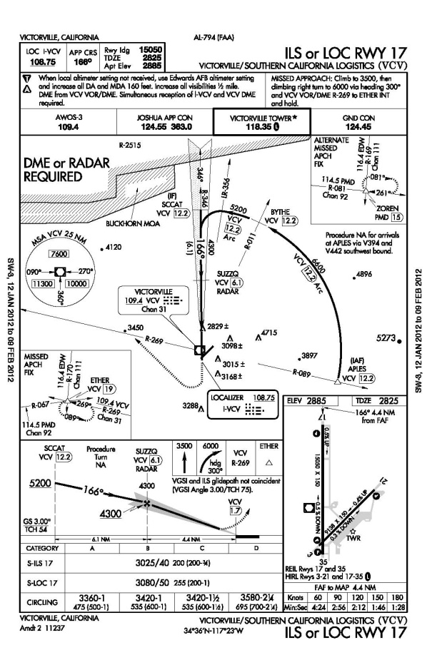
Retain VORs to perform ILS, Localizer or VOR approaches within 100 NM of any location in the CONUS
Fail

Slide 42
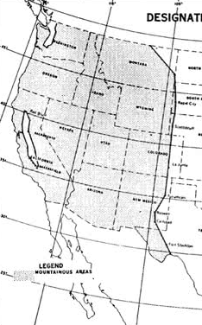
Retain most VORs in the Western US Mountainous Area for the Victor airways in high elevation terrain
Fail

Slide 43

Retain VORs for Military Use
Fail

Slide 44
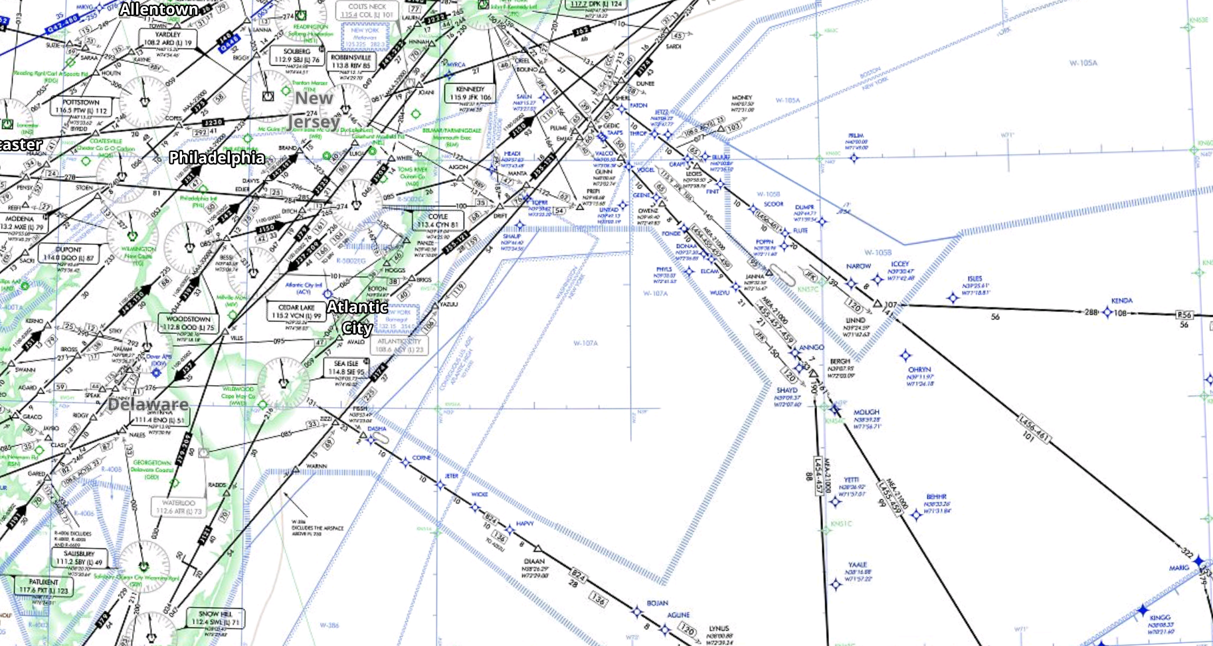
Retain VORs to support International Oceanic Arrival Routes
Fail

Slide 45
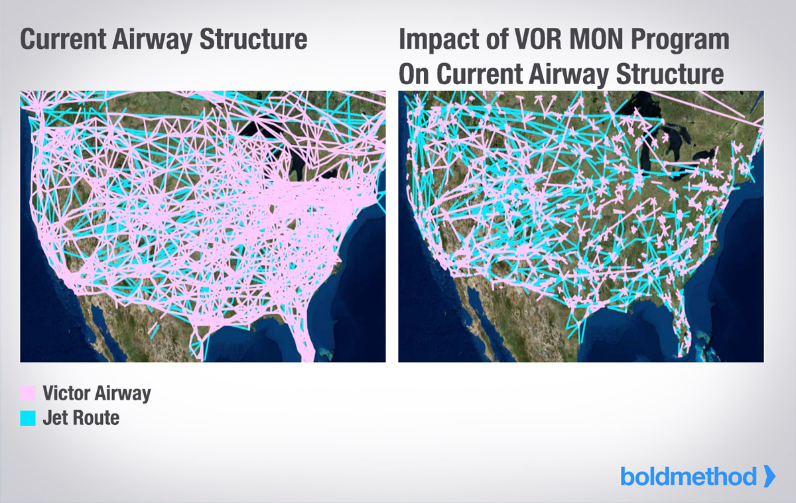
Minimum Operating Network

Slide 46

ADS-B
ADS-B Mandate

Slide 47


ADS-B
67
days
44
Working
days
Notes:
If you don’t have ADS-B installed, as quick as you turn the page on 2019, you won’t be able to fly in the following airspace:
Class A airspace
Class B airspace (within the 30 nm veil) – up to 10,000 feet
In & Above Class C airspace – up to 10,000 feet
Above 10,000’ MSL (excludes airspace below 2,500 AGL)
(Reference AC 90-114, change 1, Sep 21, 2012)

Slide 48


Slide 49
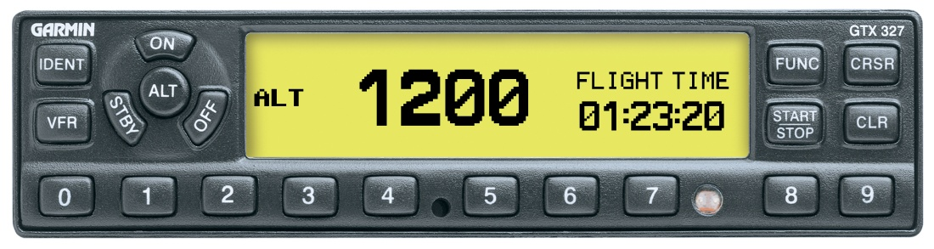
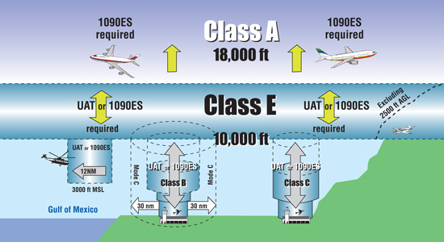
Same as Mode C Rules

Slide 50
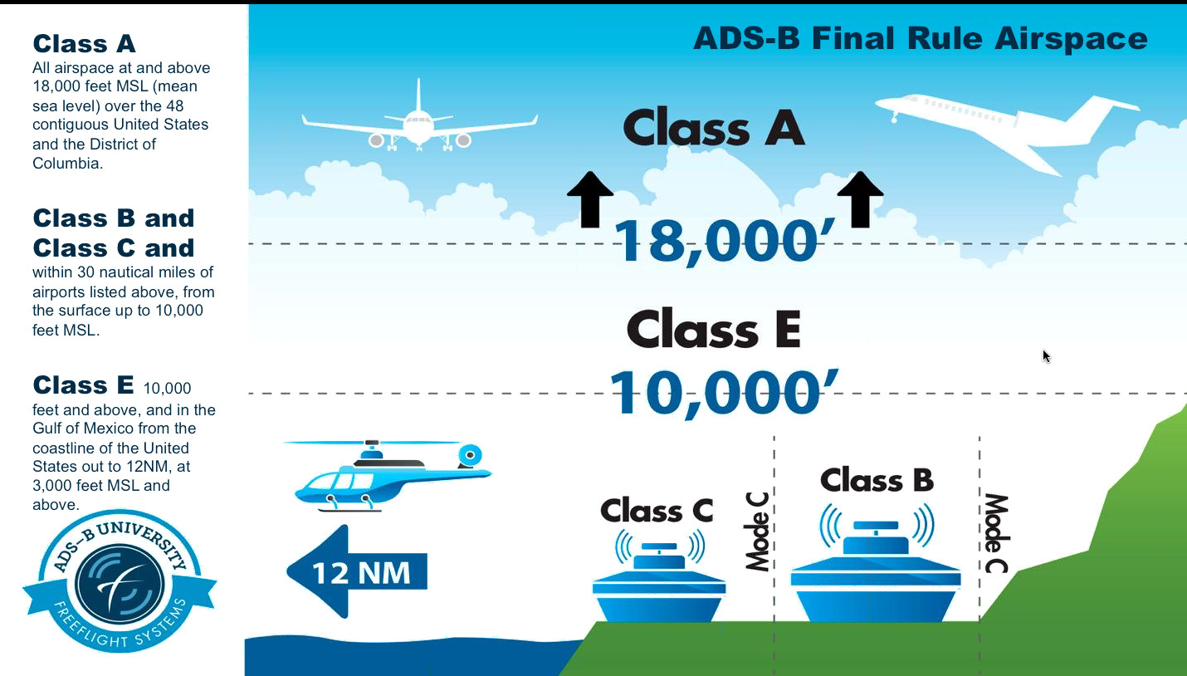
ADS-B

Slide 51
ADS-B
Excluding
and above

Slide 52
ADS-B
to 10,000 feet
Veil
Veil

Slide 53
ADS-B
to 10,000 feet

Slide 54
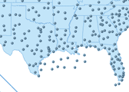
ADS-B
Gulf of Mexico
3,000 MSL or higher
Within

Slide 55
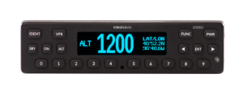
ADS-B
FAR 91.225(f)
“. . . each person operating an aircraft equipped with ADS-B Out must operate this equipment in the transmit mode
”

Slide 56


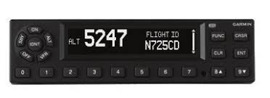
Phase 1, Jan 1, 2021 All airspace over 18,000 feet.
Jan 1, 2021

Slide 57

Phase 2, Jan 1, 2022 Adds Class B airspace (12,500 feet MSL up to but not including 18,000 feet MSL)
Jan 1, 2022

Slide 58
Phase 3, Jan 1, 2023 ADS-B airspace expanded as needed to “specific controlled airspace, en- route or at an airport”
Jan 1, 2023

Slide 59
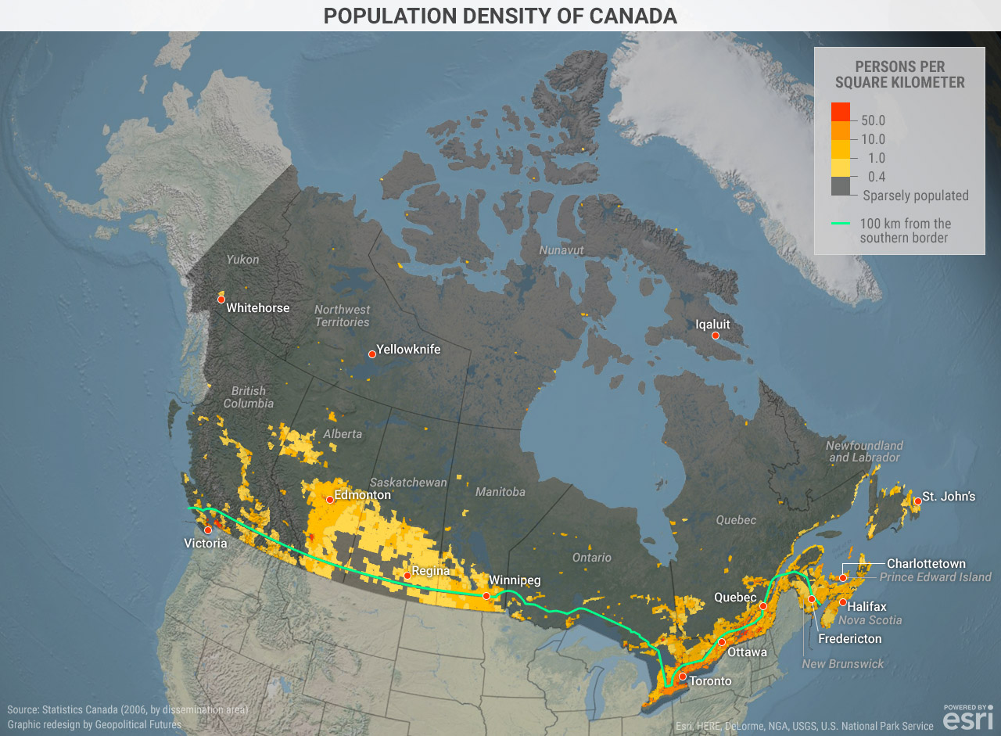

Slide 60
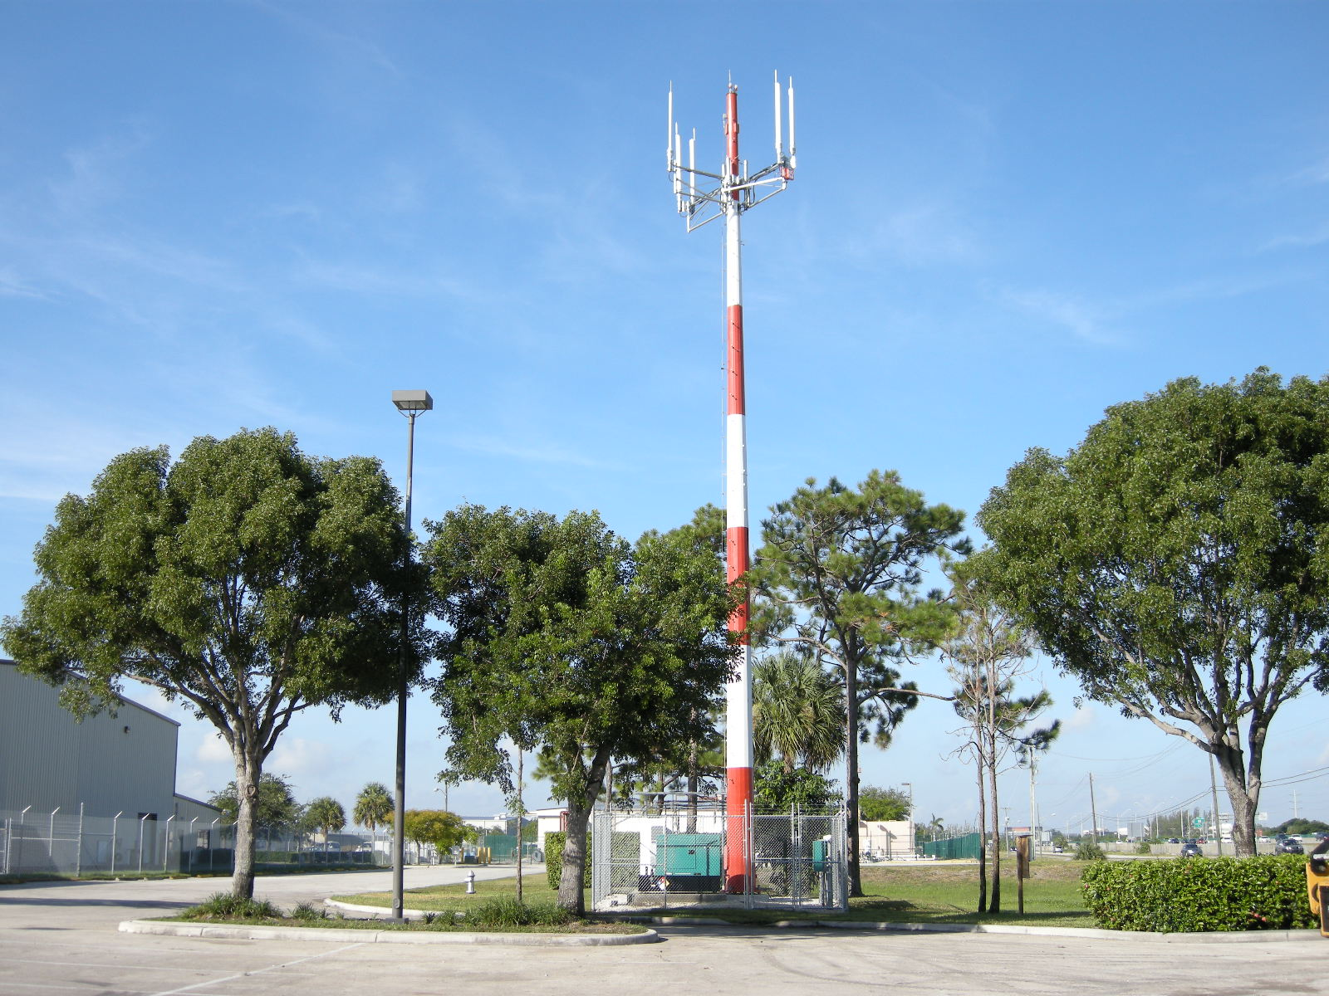
ADS-B Tower distribution won’t work in Canada

Slide 61

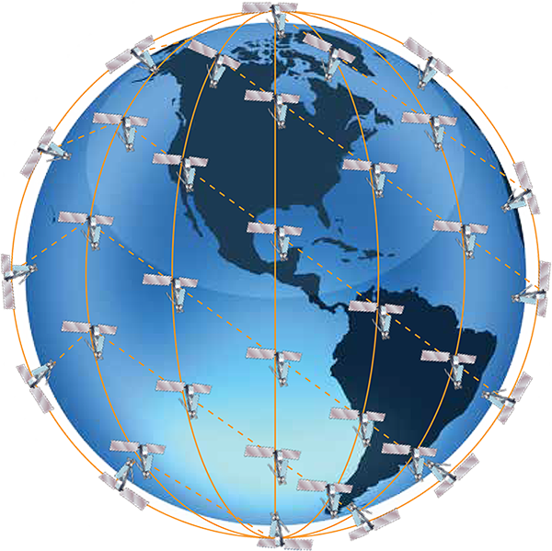
Iridium Satellite Network

Slide 62
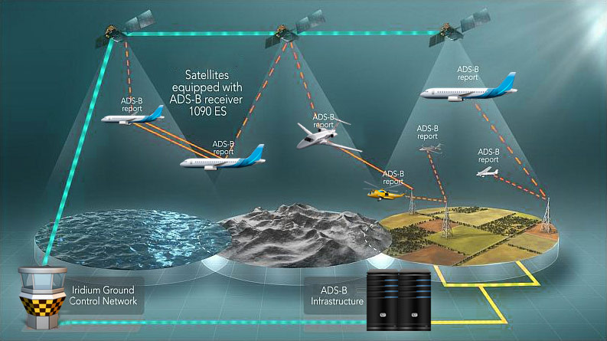
Aireon + Iridium

Slide 63
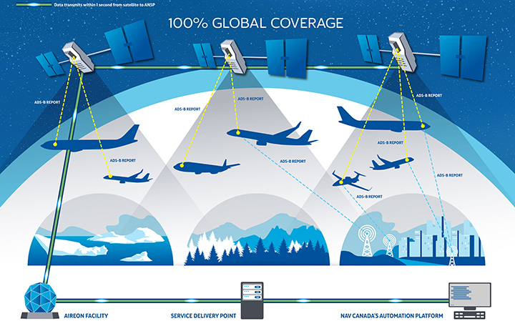
Satellite Based & require Diversity ADS-B Transponder(Top & bottom antennae)

Slide 64


Same Mandate as USA
2020

Slide 65

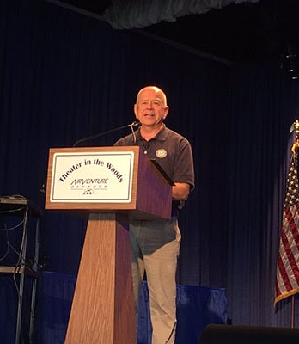
“ADS-B deadline won’t change”, FAA administrator Huerta

Slide 66
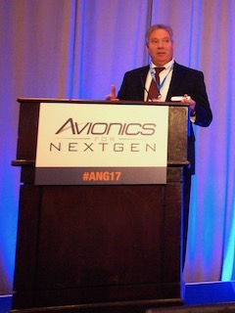
FAA's James Marks, “Avionics for NextGen”, 2017 Nov. 15
It may seem like the FAA’s Exemption 12555, gives airlines an extra five years to equip with ADS-B Out. That, however, is not the case.

Slide 67
FAA's James Marks, “Avionics for NextGen”, 2017 Nov. 15
“All the exemption does is buy [the airlines] five more years to replace those old positioning sources with one of the new positioning sources,”
“[They’ll] still have to have an ADS-B Out system come 2020.”

Slide 68

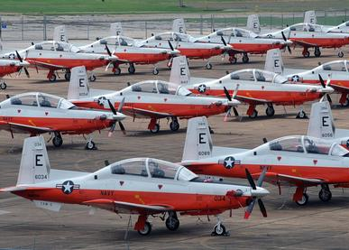
US Navy to Procure $7M Worth of ADS-B for T-6s

Slide 69
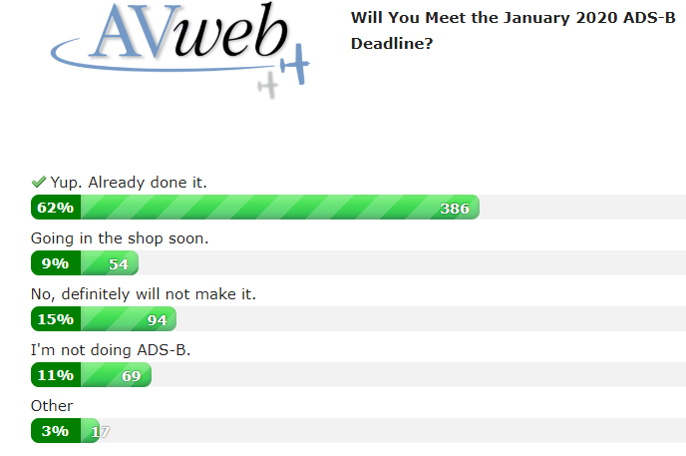
Poll, 27 September 2019
29%

Slide 70
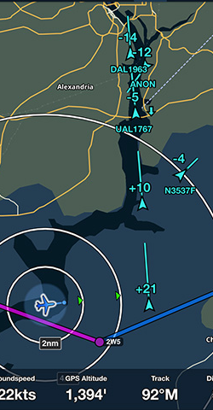
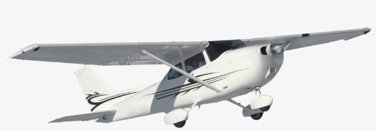
July 2019:
56%
36%
106,000 – 167,000 general aviation aircraft may need to equip with ADS-B
60,000 aircraft have been equipped
X1

Slide 71
ADS-B
ADS-B
Ground Towers
Notes:
ADS-B GROUND STATIONS

Slide 72
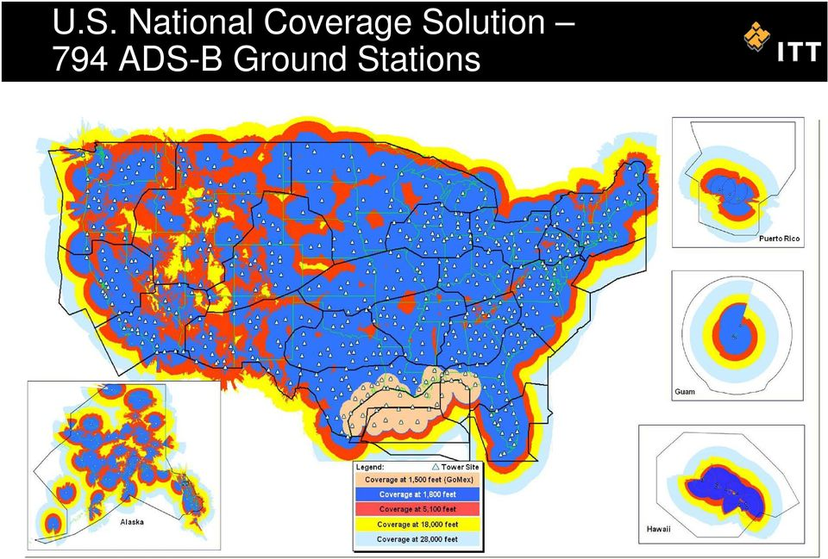
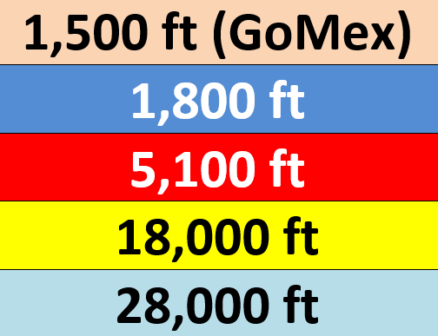

Slide 73


Slide 74



Slide 75

10,500 MSL – Receiving 7 Towers

Slide 76

18 Arizona Towers
Coverage at 1,500 ft. AGL
Coverage
Gaps

Slide 77



ADS-B
Line of Sight
X1
Notes:
Towers are Line of Sight. When an airplane’s transmissions and reception is blocked by a mountain, Amen to ALL ADS-B activity for that aircraft.

Slide 78


ADS-B
If you have experienced problems receiving ADS-B Weather or Traffic in a particular area, or have any other ADS-B problems,
https://www.faa.gov/nextgen/programs/adsb/
Traffic
Weather
Notes:
Questions

Slide 79

ADS-B
Bands
Notes:
BANDS

Slide 80


Universal Access Transceiver
UAT
978 MHz
POSITION
Notes:
UATS are 978 MHZ and are IN AND OUT

Slide 81

Ample Bandwidth for Weather

Slide 82


Do you fly to Mexico or in Class A? These are not the ADS-B transmitters you’re looking for.

Slide 83


UAT
Class A
Notes:
UATS are 978 MHZ and are IN AND OUT

Slide 84

ADS-B
Extended Squitter (ES) Transponder
1090 MHz
Your POSITION
Notes:
MOST ADS-B 1090 MHz TRANSPONDERS are OUT ONLY

Slide 85



ADS-B
Class A
Notes:
MOST ADS-B 1090 MHz TRANSPONDERS are OUT ONLY

Slide 86
Rebroadcast
ADS-B
Notes:
Rebroadcast

Slide 87


ADS-B
ADS-R
978MHz
978MHz
Rebroadcast
Notes:
Rebroadcast

Slide 88


ADS-B
Notes:
IN & OUT

Slide 89

ADS-B
Transmitting
/ Reporting
Notes:
Out is concerned with transmitting your position, altitude, N number, etc to the controller

Slide 90

ADS-B
ADS-B “Out”
Can Send
49
Parameters
Notes:
Out is concerned with transmitting your position, altitude, N number, etc to the controller

Slide 91




ADS-B
Mode 3/A Code
Track & GS
ICAO Code
Altitude
Aircraft Model
Aircraft Dimensions
GPS Flight Plan
Light, Med, Heavy
GPS Position
Notes:
The 49 parameters include: Who you are, position, altitude, heading, track, ground speed and flight plan, and which band you’re using.

Slide 92
ADS-B
Receiving
Notes:
In is concerned with giving you FREE weather and traffic products that you can see on your panel or on an iPad

Slide 93



ADS-B
Notes:
In is concerned with giving you FREE weather and traffic products that you can see on your panel or on an iPad

Slide 94


ADS-B
or
Notes:
Displayed on the panel or iPad

Slide 95






ADS-B
Jan 1, 2020
Notes:
Out or Transmitting is mandated by Jan 1, 2020
In or receiving is optional

Slide 96


Time to upgrade your panel?

Slide 97

Time to update your transponder?

Slide 98

Do you operate under an authorized call sign?

Slide 99

Consider Scheduling Issues

Slide 100

Do I really need to install ADS-B by Jan 1, 2020?

Slide 101
You can fly anywhere, including Rule Airspace

Slide 102

Why Install ADS-B?
ADS-B enhances safety and efficiency, and directly benefits pilots, controllers, airports, airlines, and the public.

Slide 103

Why Install ADS-B?
Pilots see same traffic that the controller sees.

Slide 104
Why Install ADS-B?
Cockpit displays show hazardous weather and terrain, and give pilots important flight information, such as temporary flight restrictions (TFRs).

Slide 105

Why Install ADS-B?
ADS-B is a great tool. It’s like having your own flight dispatcher, constantly updating and advising you.

Slide 106





No Electrical System?
1X

Slide 107



Should I equip my modest aircraft with ADS-B? Is it worth it?

Slide 108

. . . when you want to sell your airplane to someone who desires ADS-B!

Slide 109
What if I don’t equip or miss the Jan. 1, 2020 deadline?
Today, there is regulatory relief allowing Mode C airspace transit with a failed Mode C transponder.
It’s the same for broken ADS-B transponders or UATs

Slide 110

FAA Issued Policy, April 1, 2019
“Statement of Policy for Authorizations to Operators of Aircraft that are Not Equipped With Automatic Dependent Surveillance-Broadcast (ADS-B) Out Equipment”

Slide 111
Authorization to fly in Rule Airspace
You’ll have to request an authorized deviation from ATC at least an hour before your proposed flight.
It’s up to each ATC facility to determine whether accommodations for non-ADS-B equipped aircraft can be made.
Approval is case by case and not automatic.
x2

Slide 112
The regulatory provision for issuing authorizations to operators of non-equipped aircraft addresses rare instances in which an operator, who does not routinely operate in ADS-B Out airspace, has a need to do so.
BOTTOM LINE:
Unequipped aircraft cannot expect uninterrupted access to ADS-B airspace
x1

Slide 113
The FAA has not planned, nor does it plan to expend a significant amount of its limited budgetary resources to establish a new system to issue authorizations for the small number of operators of non-equipped aircraft seeking occasional access to ADS-B Out airspace.

Slide 114

ADS-B
2020 Mandate
Need 2
Things
Notes:
Need 2 things to meet the 2020 Mandate

Slide 115

ADS-B
A WAAS GPS Position Source
Notes:
1st: You need a WAAS Position Source

Slide 116



ADS-B
Panel Mounted WAAS GPS
Notes:
1st: a WAAS Position Source

Slide 117



WAAS equipped Transmitter

Slide 118

Experimental Aircraft Exception

Slide 119

Uncertified GSP is OK The FAA has concluded that devices must meet the "performance requirements" of TSO-C154c.

Slide 120

A Transmitter

Slide 121


Extended Squitter Transponder (ES)

Slide 122

Universal Access Transceiver (UAT)
Below Class A

Slide 123
Experimental Aircraft Exception

Slide 124
Uncertified Transmitter is OK The FAA has concluded that devices must meet the "performance requirements" of TSO-C154c.

Slide 125
Aircraft not covered by a supplemental type certificate (STC)? The installer does need to obtain permission from the original STC holder.

Slide 126

Why do we need WAAS?

Slide 127

Disturbances from Ionosphere
Timing Errors
Satellite Orbit Errors

Slide 128


Slide 129

ADS-B
WAAS GPS
Panel Mounted
Notes:
WAAS

Slide 130


WAAS Upgrade: $4,495

Slide 131

ADS-B
LPV Approach
with
Localizer
Performance
Vertical Guidance
Notes:
Flying an LPV approach #3

Slide 132

ADS-B
LPV Approach
Notes:
Flying an LPV approach #3

Slide 133


ADS-B
Panguich, UT
Pop: 1,623
Notes:
Small towns can have the luxury of an LPV approach with a Decision Altitude of 200 feet above the field elevation!

Slide 134

ADS-B
WAAS Ensures System Integrity
finds problems fast – before it’s too late
Notes:
WAAS finds integrity problems fast, before it’s too late

Slide 135

ADS-B
3,567 LPV approaches:
serving 1,739 airports
< 1,450 in the US
ILS approaches:
Notes:
Flying an LPV approach #3

Slide 136

GTN 750, $14,500 GTN 650, $9,800

Slide 137


IFD550, $13,500
IFD440, $10,000

Slide 138

ADS-B
Extended Squitter
More data
Per Squit
Notes:
Extended Squitter

Slide 139


Mode S Traffic 55 mile radius of any Class B or Class C airport

Slide 140

Mode S Radar Sites

Slide 141

ADS-B
Notes:
Mode S on my Aspen Dispalys

Slide 142



ADS-B
Upgrading from GTX 330 Mode S to ES
$1,150
Notes:
If you already have a Garmin GTX 330 Mode S transponder, and you want to upgrade it to the 330ES,
Garmin will do that upgrade for $1,150. Install time is ~4 hours.

Slide 143
Already have a WAAS GPS?

Slide 144



$2,900
GTX 335

Slide 145

$6,500
GTX 335D

Slide 146

$4,300
GTX 345

Slide 147

$8,000
GTX 345D

Slide 148

$2,500
Stratus ES

Slide 149


Slide 150

ESi Kit, add $500

Slide 151
Don’t have a WAAS GPS?

Slide 152

$3,200 ($300 more)
GTX 335 (ES)

Slide 153



Garmin GTX 345, $5,000 ($700 more)

Slide 154
$3,000 ($500 more)
Stratus ESG

Slide 155
ESGi Kit, add $500

Slide 156



ADS-B
Notes:
L3 Lynx NGT 9000 – 9000+ with WAAS inside are In and Out (1090 and 978 MHz)

Slide 157

Notes:
L3 Lynx NGT 9000 – 9000+ with WAAS inside are In and Out (1090 and 978 MHz)

Slide 158

Lynx NGT 9000, $5,100

Slide 159



ADS-B
Notes:
Questions

Slide 160

ADS-B
UAT
Universal Access Transceiver
Notes:
UAT

Slide 161


ADS-B
Keep!
Mode C Transponder
Notes:
One of the benefits of installing a UAT, is that you can keep your Mode C Transponder..

Slide 162

ADS-B
UAT
Some Models
Notes:
Specific only to United States airspace – and not approved elsewhere – is the UAT (Universal Access Transceiver)
The UAT is USAULLY both “in” and an “out” capable.

Slide 163

ADS-B
UAT
WiFi Module

Slide 164



How the UAT gets the Code

Slide 165
Already have a WAAS GPS?

Slide 166
GDL 88, $3,500

Slide 167
Don’t have a WAAS GPS?

Slide 168

$1,800
GDL 82

Slide 169

ADS-B
GDL 82
Labor: 8 – 12 hours
Notes:
UAT Installation costs more than a Transponder installation

Slide 170



GDL 84 $3,500 - $3,900

Slide 171

GDL 88W $4,500 - $5,000

Slide 172


Ranger FDL-978-TXL, $1,995

Slide 173

Ranger FDL-978-XVRL, $3,695

Slide 174

All L-3 UATs have

Slide 175

Lynx NGT 1000 $2,189

Slide 176



$3,200
Lynx NGT 2000
Wing X SkyRadar

Slide 177

Lynx NGT
2500
$3,500

Slide 178


skyBeacon,
$1,850

Slide 179


Installation

Slide 180




Slide 181
Garmin International and uAvionix announced a patent lawsuit settlement October 17 [2019] that allows uAvionix to continue selling and supporting its ADS-B product line.

Slide 182

Any A&P IA can install & certify

Slide 183

tailBeacon, $1,995
STC approval, Sep 13, 2019

Slide 184


Older Transponders are 75w
Owners end up buying a more powerful transponder with enough wattage
GTX 327 has
200 watts nominal
$500 - $1,000

Slide 185



tailBeacon, $1,995
$1,000
labor

Slide 186



Slide 187
$3,000
Stratus ESG

Slide 188


Slide 189

978 MHz FIS-B
Flight
Information
Services
Broadcast

Slide 190


ADS-B
WINDS
ALOFT
Notes:
Questions

Slide 191



ADS-B
Differences: XM & FIS-B
978 MHz
Cloud Tops
Lightning
Turbulence
Icing
Notes:
By the end of 2017

Slide 192

ADS-B
Different Tower Tiers
for Different Jobs
At select
airports
Surface:
Low: 67%
Medium: 22%
High: 11%
Notes:
The different Tiers have different jojbs

Slide 193

ADS-B
Station Type Weather Products and Range
Notes:
The different Tiers have different jojbs

Slide 194




ADS-B
ADS-B
Notes:
ADS-B You can receive XM weather while you’re on the ground,
but for ADS-B weather, you need to be airborne.
Sporty’s airport in Batavia, OH is about 30 miles from the closest ADS-B ground station, yet pilots routinely pick up that station up after takeoff at 200 ft. AGL using a Stratus.

Slide 195


ADS-B
Weather & Traffic Reception at 500’ AGL
Notes:
The higher you go, the better the coverage. If you’re flying higher than 1,500 AGL, in theory, you can fill in some of the small gaps shown in gray.

Slide 196

ADS-B
Weather & Traffic Reception at 1,500’ AGL
Notes:
The higher you go, the better the coverage. If you’re flying higher than 1,500 AGL, in theory, you can fill in some of the small gaps shown in gray.

Slide 197

ADS-B
Weather & Traffic Reception at 3,000’ AGL
Notes:
The higher you go, the better the coverage. If you’re flying higher than 1,500 AGL, in theory, you can fill in some of the small gaps shown in gray.

Slide 198

ADS-B
Weather & Traffic Reception at 5,000’ AGL
Notes:
The higher you go, the better the coverage. If you’re flying higher than 1,500 AGL, in theory, you can fill in some of the small gaps shown in gray.

Slide 199

ADS-B
Notes:
ADS-B NexRad is subject to latency. In extreme latency and mosaic-creation scenarios, the actual age of the oldest NEXRAD data in the mosaic can EXCEED the age indicated in the cockpit by 15 to 20 minutes. –

Slide 200


Latency

Slide 201

ADS-B
Old News
Notes:
Nexrad is ancient history!

Slide 202


ADS-B
Notes:
When a thunderstorm is developing, 10 minutes could be a lifetime.

Slide 203
Strategic Planning

Slide 204

978 & 1090 MHz TIS-B
Traffic
Information
Services
Broadcast

Slide 205


ADS-B
1X
Notes:
Questions

Slide 206

ADS-B
Repeats, 978 MHz
Notes:
Questions

Slide 207

ADS-B
Notes:
Questions

Slide 208

ADS-B
Notes:
Questions

Slide 209


ADS-B
ADS-B “IN” Equipped
Non-ADS-B Out
Aircraft
Notes:
Questions

Slide 210

The Hockey Puck

Slide 211

ADS-B
Notes:
Questions

Slide 212



ADS-B
Notes:
If you have a 1090 MHz Extended Squitter transponder, like the GTX 330ES , or
a 978 MHz UAT like the Garmin GDL88, --
Every time it sends a position report to an ADS-B ground station, that position report prompts the ground station to send back a Traffic Information Service Broadcast - TIS-B package or “Hockey Puck”
In this 15mi radius and +/- 3,500 feet “Hockey Puck”, there will be all the traffic around you – aircraft that are ADS-B equipped, and those equipped with only with Mode C.
You just need to be ADS-B “IN” and “OUT” equipped to see the total traffic package.

Slide 213

ADS-B
Find a Dealer

Slide 214

ADS-B
https://www.L-3avionics.com/
Notes:
L3 Dealers

Slide 215

ADS-B
Perfect Install?
Notes:
UAT

Slide 216

20% fail the performance check

Slide 217


ADS-B PAPR
Public ADS-B Performance Report (PAPR)
https://adsbperformance.faa.gov/PAPRRequest.aspx

Slide 218

It’s quick

Slide 219

October 2013
My GTX330ES

Slide 220

ADS-B
Common Installation Issues:
UAT code disagrees with transponder code
Software incompatibility
Wrong / partial ICAO code or Flight ID
Incorrect flight identification,
Dual-Out boxes using different ICAO codes

Slide 221



ADS-B
1st, 2nd & 3rd Tries
X1
Notes:
My 1st, 2nd & 3rd Tries reports

Slide 222


ADS-B
ADS-B ground testing equipment, as shown here, can verify all parameters are correct before you fly.

Slide 223

Non-Performing
Emitters (NPE)

Slide 224


7,700 aircraft with NPE
ADS-B was likely installed more than four years ago or prior to changes made in the mandate and implemented over the years after its initial announcement.
Some, however, may be a result of an improper installation or equipment configuration

Slide 225
Some common reasons the emitter may not be transmitting:
Incorrect software version or improper configuration. Either issue can reduce the accuracy of the aircraft’s position
Incorrect emitter category. This happens when the ADS-B system transmits the wrong emitter category based on its maximum take-off weight
Incorrect Flight ID. This happens when the aircraft’s registration for Mode S doesn’t match the Flight ID
Transmitting airborne data. An error when the signal is transmitting but the aircraft is on the ground

Slide 226

ADS-B
ADS-B “In” apps & Receivers
Notes:
Squitter

Slide 227

Traffic (TIS-B) & Weather (FIS-B)

Slide 228





ADS-B
>50%
Notes:
Questions

Slide 229







ADS-B
Garmin Pilot
Garmin Pilot
iFlight Planner
Direct to Aviation GPS
WingX Pro
Notes:
Questions

Slide 230






ADS-B
Portable Receivers (ADS-B “in”)

Slide 231



Stratus 3, $699

Slide 232

ForeFlight, Fltplan Go, FlyQ, WingX, and iFly GPS

Slide 233


Sentry $500 Includes a Carbon Monoxide Alarm
ForeFlight
ONLY

Slide 234




Sentry Mini $300

Slide 235



Scout $200
GPS
ForeFlight
ONLY

Slide 236

Comparison

Slide 237


XGPS190 $200 Works with everything

Slide 238


$250 Doesn’t work with Garmin Pilot

Slide 239


Garmin GDLs work with Garmin Pilot, ForeFlight, Fltplan Go and the Garmin line of Portables

Slide 240
GDL 50 $800 ADS-B

Slide 241



GDL 51 $650 XM Receiver
only

Slide 242

GDL 52 $1,149 ADS-B & XM Receiver

Slide 243



ADS-B
$225
Works with: Everything

Slide 244



ADS-B

Slide 245


for flying apps

Slide 246

Fuel Prices

Slide 247

NEXRAD

Slide 248

Airport Information and Weather

Slide 249


SIGMETs, TFRs, METARs, TAFs

Slide 250
NOTAMs and TFRs

Slide 251

iPad Traffic

Slide 252



ADS-B
Notes:
Traffic on an iPad, using Appareo Stratus, ForeFlight and an iPad

Slide 253


ADS-B
+ or - 3,500 ft
15nm radius
Notes:
You can filter the traffic display on ForeFlight.
Just to go “Settings”, and turn the Traffic Filter “ON”. It will restrict the traffic view to something more relevant: - +/- 3,500’ and 15 nm.

Slide 254

TIS-B Weakness Can’t see low flying aircraft outside the range of ADS-B Ground Stations

Slide 255

TIS-B Weaknesses Can’t see aircraft that are not equipped with transponders

Slide 256

ADS-B
ADS-B Investment
Notes:
What suits you best?

Slide 257

ADS-B
Notes:
Questions

Slide 258
ADS-B
Notes:
Where do you fly? Do you like to fly at or above 10,000 feet MSL?

Slide 259

ADS-B

Slide 260

ADS-B
Installation Sunset
Notes:
Get it done before “sunset”

Slide 261

ADS-B
Except airplanes –
Those things are dang expensive

Slide 262






ADS-B
1960
Notes:
Questions

Slide 263




ADS-B
Today’s $
$7,300
1X
Notes:
That’s $7,300 in 2016 dollars + install

Slide 264


ADS-B
143,000 GA aircraft routinely fly in ADS-B Rule Airspace
Notes:
Well before Tuesday, December 31, 2019

Slide 265

ADS-B
Notes:
Questions

Slide 266


Slide 267

ADS-B
Notes:
(AUTO) Get a bid from an Avionics shop that you can trust. If the shop knows less about ADS-B than you know now, then don’t stick around and hope that you might be able to teach them.
Remember that your aircraft will be in the shop for at least a few days for an extended squitter transponder install and a week or more for a UAT install.

Slide 268


ADS-B
Questions
Notes:
Questions

Slide 269
ADS-B
Notes:
Questions

